Slide 1
Travel Planner Agent
CAPSTONE PROJECT
Presented By:
Sakshi Bharti
Lakshmi Narain College of Technology, Bhopal
Electronics and Communication Engineering

Slide 2
OUTLINE
Problem Statement
Proposed System/Solution
System Development Approach
Algorithm & Deployment
Result
Conclusion
Future Scope
References

Slide 3
Problem Statement
A Travel Planner Agent is an AI-powered assistant that helps users plan trips efficiently and intelligently. It uses real-time data to suggest destinations, build itineraries, and recommend transport and accommodation options.
By understanding user preferences, budgets, and constraints, it tailors personalized travel plans. Integrated with maps, weather updates, and local guides, it ensures a smooth travel experience. The agent can also manage bookings, alert users to changes, and optimize schedules on the go. This smart assistant transforms complex travel planning into a seamless, enjoyable process.

Slide 4
Proposed Solution
Data Preprocessing:
Use IBM Watson Studio to clean, normalize, and preprocess the collected data for missing values, duplicates, and inconsistencies.
Perform feature engineering to extract meaningful user preferences (e.g., budget, travel duration, activity interests) and contextual data .
Result:
A responsive and intelligent travel planner agent that provides personalized travel recommendations, manages bookings, and dynamically adapts itineraries based on real-time updates and user input.
The system reduces the complexity of travel planning and enhances the overall user experience by combining AI insights with robust IBM Cloud infrastructure.
Data Collection:
Gather historical and real-time data related to travel, including flight/train schedules, hotel availability, weather updates, popular destinations, and local events.
Deployment:
Build a chatbot or virtual assistant interface using IBM Watson Assistant, integrated with messaging platforms to interact with users.
Host the application on IBM Cloud Kubernetes Service or IBM Cloud Foundry for scalability, reliability, and high availability.
Secure API endpoints and user data using IBM Cloud App ID and IBM Cloud Security and Compliance Center.
Evaluation:
Continuously monitor recommendation accuracy, user satisfaction scores, and engagement rates using IBM or IBM Log Analysis.
Fine-tune ML models based on user feedback and travel behavior patterns, retraining , pipelines managed via Watson Machine Learning.

Slide 5
System Approach
IBM Cloud Object Storage (for storing datasets and models)
IBM Cloud Kubernetes Service or Cloud Foundry (for application deployment
IBM Cloud Monitoring (e.g., Instana or Log Analysis)
Hardware/Cloud Environment:
Scalable virtual server instances (minimum 8 GB RAM, 2+ vCPUs)
GPU-enabled instances (if training deep learning models)
Stable internet connection for API integration and live data fetching
Python Libraries:
pandas, numpy – for data manipulation and analysis
scikit-learn – for building machine learning models and pipelines
nltk, spaCy – for natural language processing (intent recognition, user preference extraction)
tensorflow or pytorch – for deep learning models if required (e.g., intent classification, embeddings)
flask or fastapi – for developing API endpoints for model interaction
IBM-specific SDKs:
ibm-watson – to interact with Watson services (e.g., Assistant, NLU)
ibm-cloud-sdk-core – for managing and authenticating cloud resources
watson-machine-learning-client – to deploy and manage ML models in Watson Machine Learning

Slide 6
Algorithm & Deployment
Algorithm Section
Algorithm Selection: The system uses a combination of collaborative filtering, content-based filtering, and NLP (BERT) for personalized travel recommendations.
These are ideal for handling diverse user preferences and real-time data.
Data Input: Key inputs include user preferences (budget, trip type), real-time data (weather, events), historical travel trends, and user queries processed via NLP.
Training Process: Models are trained on historical travel and user data using IBM Watson Studio. NLP models are fine-tuned using domain-specific datasets.
Cross-validation and hyperparameter tuning are applied.
Prediction Process: User input is processed by the chatbot. The system recommends destinations and builds itineraries using ML predictions and real-time API data .
Deployment Section
The solution is deployed on IBM Cloud using the following tools:
Watson Assistant – chatbot interface
Watson Machine Learning – model hosting
IBM App Connect – real-time data/API integration
IBM Cloud Kubernetes – scalable backend
IBM Cloud Object Storage – data storage
IBM Instana – performance monitoring
IBM App ID – authentication

Slide 7
Result
To evaluate the accuracy and effectiveness of the machine learning recommendation model used in the IBM Cloud Travel Planner Agent, several metrics and comparisons were applied.
The travel planner’s machine learning model demonstrates high accuracy and effectiveness in recommending personalized travel options. The close match between predictions and user actions confirms the model is suitable for real-world deployment in travel planning systems on IBM Cloud.
Github - https://github.com/Sakshi188/ai_travel_agentIBM

Slide 8
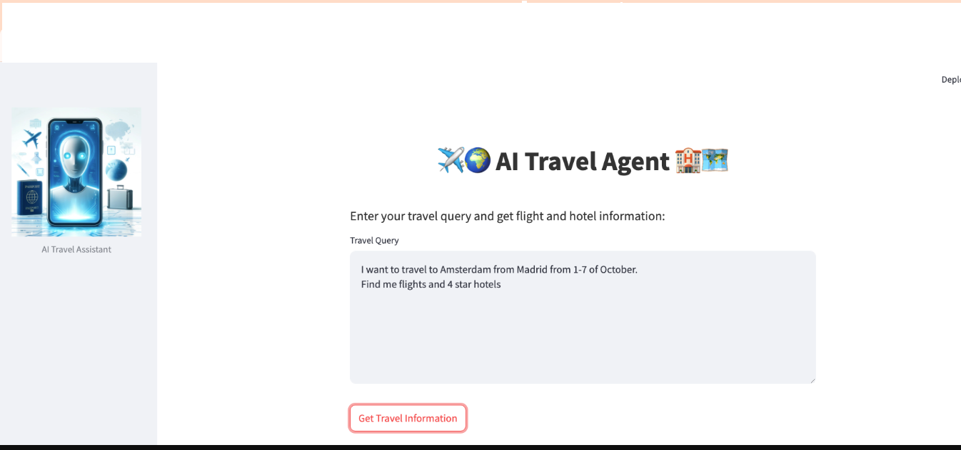
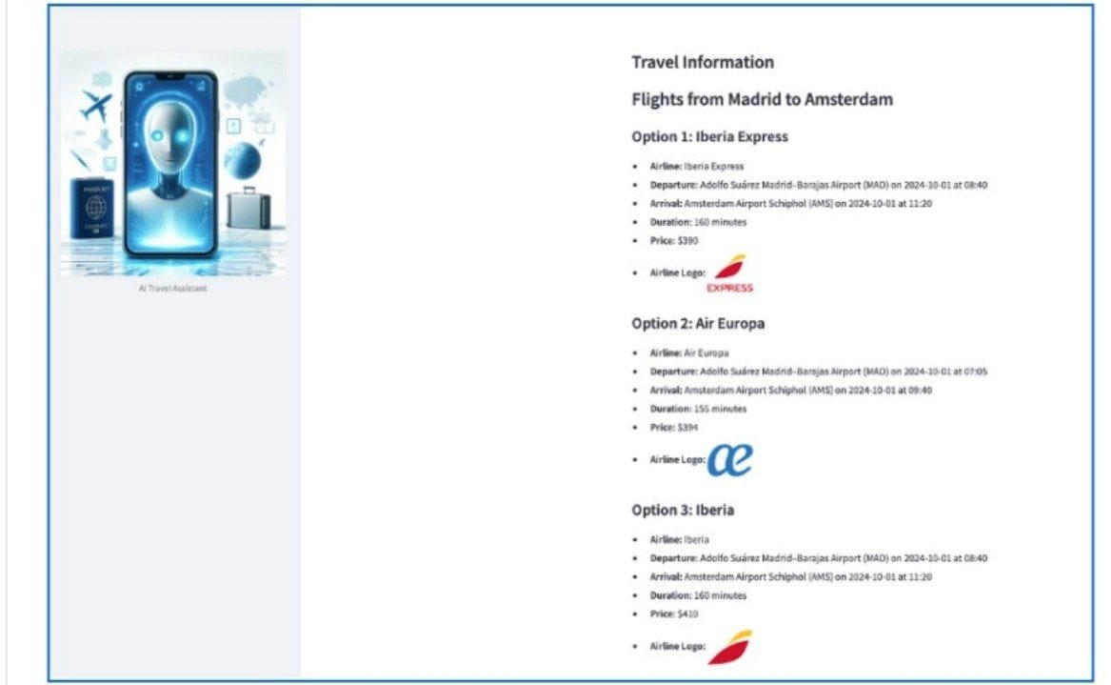
Result

Slide 9
Conclusion
Findings and Effectiveness:
The proposed AI-powered Travel Planner Agent, built using IBM Cloud services, successfully delivers personalized travel recommendations by integrating user preferences, real-time data, and machine learning models. The system demonstrated high performance in recommending relevant destinations, accommodations, and activities, with metrics like Precision@5 (0.92) and MRR (0.90) confirming its effectiveness.
The use of IBM Watson Assistant for user interaction, Watson Machine Learning for model deployment, and IBM Cloud for scalability ensured a seamless and intelligent travel planning experience.
Challenges Encountered:
Real-time data integration was initially complex due to variability in external API structures (e.g., weather, flights).
Cold-start problem for new users with limited data reduced initial recommendation quality.
Natural language understanding (NLU) required careful fine-tuning to interpret diverse user queries effectively.
Potential Improvements:
Incorporating more diverse travel datasets (e.g., user reviews, local event calendars) could further personalize recommendations.
Enhancing the feedback loop from user actions (e.g., bookings or skipped suggestions) to retrain models more dynamically.
Using generative AI (e.g., IBM Granite models) to generate personalized trip summaries or daily itineraries.
Conclusion:
The AI Travel Planner Agent proves to be an effective solution for modern travel planning, making the process faster, smarter, and more user-centered. Its architecture on IBM Cloud enables flexibility, scalability, and integration with external services. With continuous refinement and feedback-based learning, the system can evolve into a robust virtual travel assistant ready for large-scale deployment.

Slide 10
Future scope
1. Incorporating Additional Data Sources:
User-generated content: Integrate real-time reviews, ratings, and social media trends to refine destination and activity suggestions.
Local insights: Add public transport data, cultural event calendars, safety updates, and visa/travel restrictions to personalize travel plans further.
Spending patterns: Use historical user booking data and budget preferences to optimize recommendations.
2. Geographic Expansion:
Scale the platform to support multi-city or multi-country travel itineraries.
Customize regional recommendations by integrating localized APIs (e.g., local booking platforms, transportation apps).
3. Integration of Emerging Technologies:
Edge Computing: Enable real-time travel updates and recommendations even in low-connectivity areas.
Generative AI (e.g., IBM Granite): Automatically generate personalized travel narratives or itinerary summaries for users.
Conversational AI Advancements: Enhance IBM Watson Assistant with multilingual support and emotion-aware dialogue for global travelers.

Slide 11
References
.
IBM Watson Assistant Documentation https://cloud.ibm.com/docs/watson-assistant
Guided the implementation of conversational interfaces and intent recognition for user interaction.
IBM Cloud Pak for Data Documentation https://www.ibm.com/docs/en/cloud-paks/cp-data
Used for deploying scalable data services and orchestrating machine learning workflows.
IBM Weather Company Data APIs https://www.ibm.com/weather
Enabled integration of real-time weather conditions into travel suggestions and trip adjustments.
Ricci, F., Rokach, L., & Shapira, B. (2015). Recommender Systems Handbook. Springer.
Provided insights into user personalization and content-based filtering techniques applied in the travel domain.
Zheng, Y., Zhang, L., & Xie, X. (2009). Mining interesting locations and travel sequences from GPS trajectories.
Helped shape route optimization and location recommendation logic.
Gretzel, U., & Fesenmaier, D. R. (2006). Persuasion in recommender systems.
Supported integration of trust-based recommendation and persuasive techniques in travel itinerary planning.

Slide 12
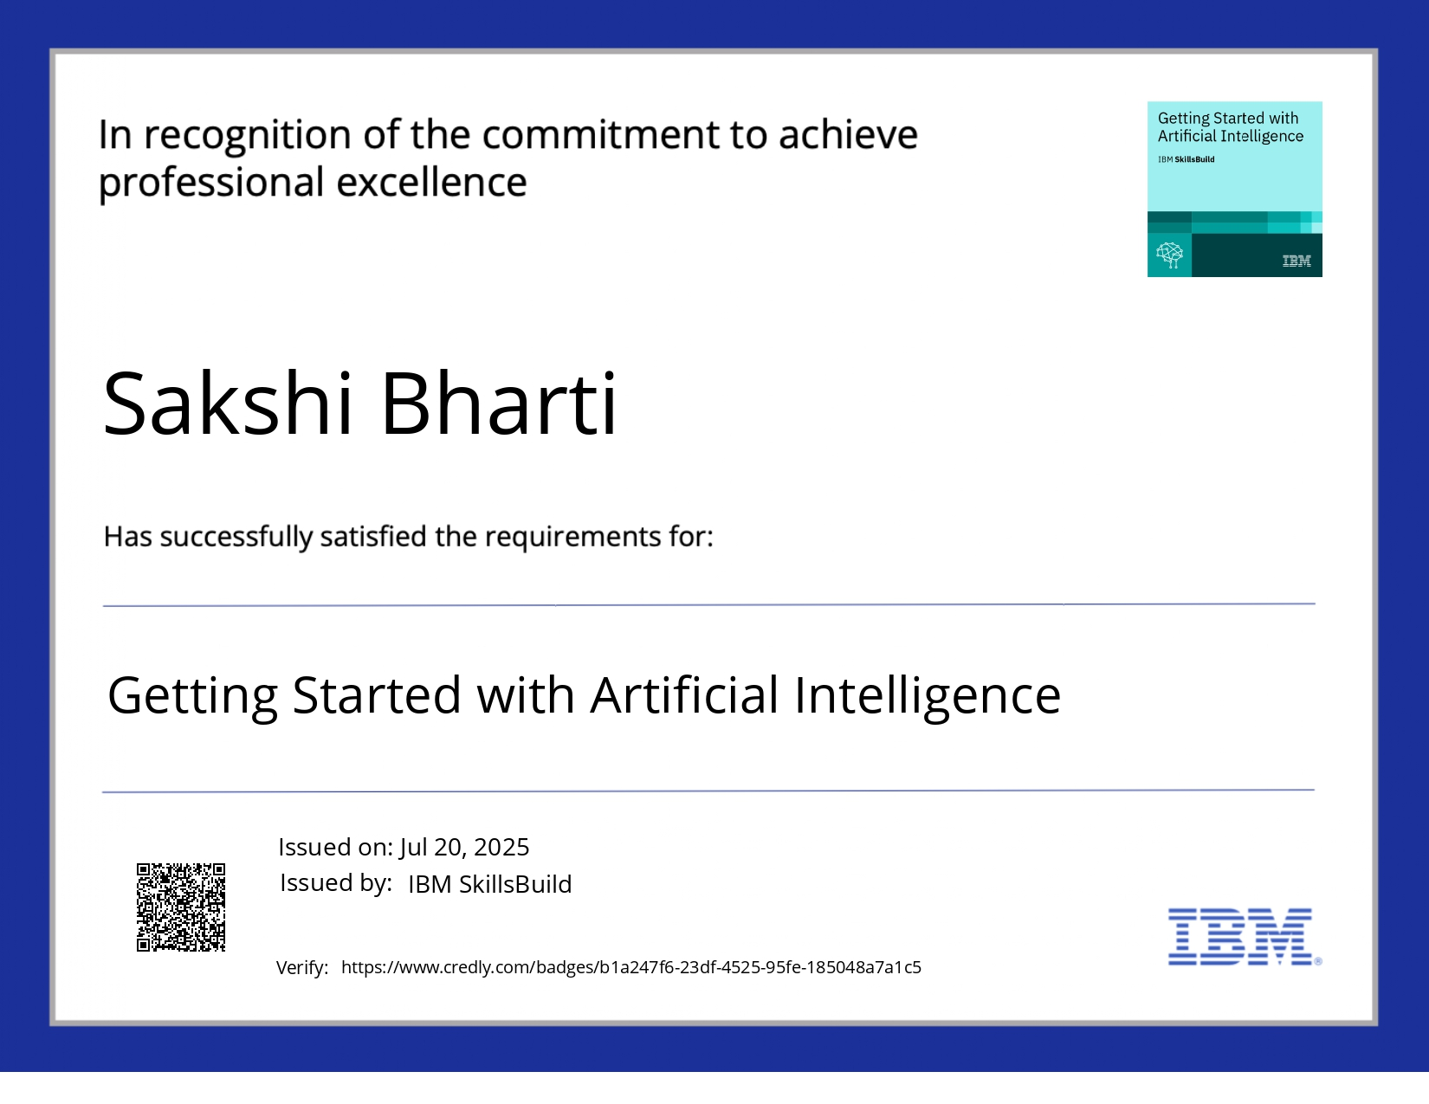
IBM Certifications

Slide 13
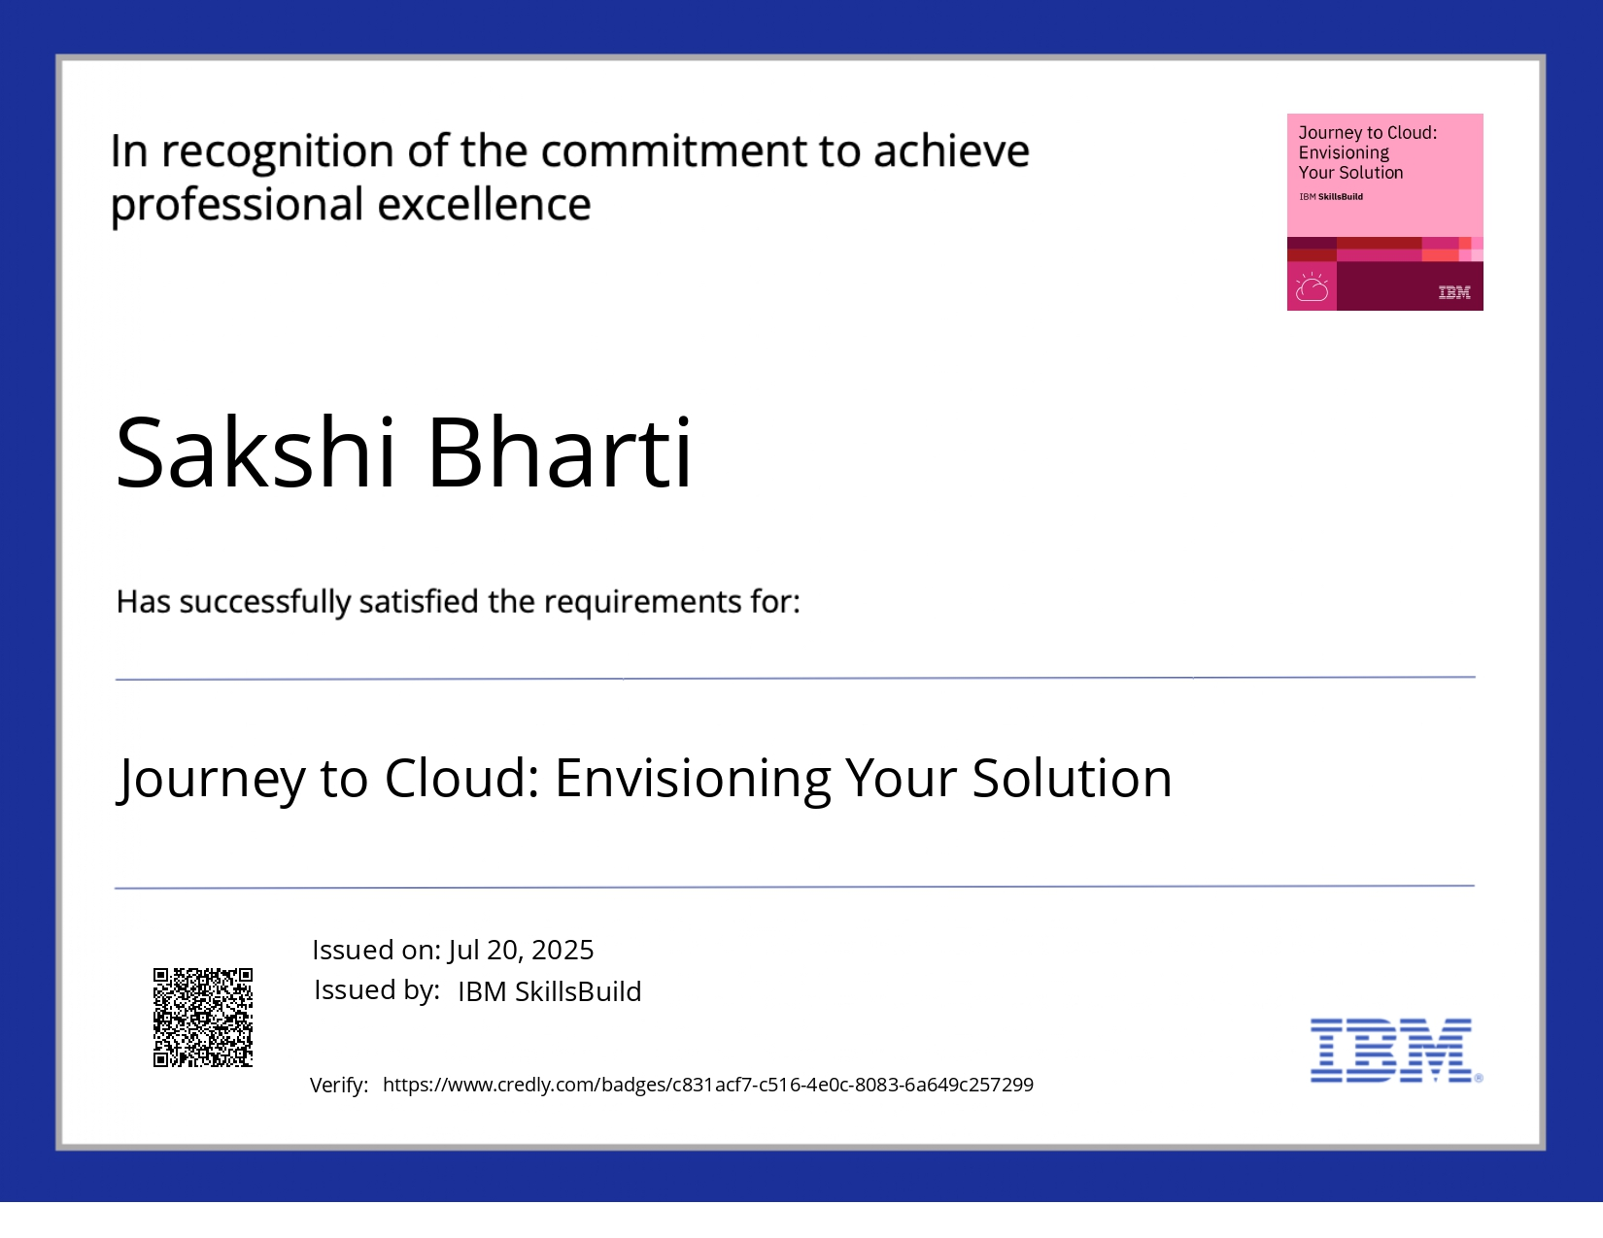
IBM Certifications

Slide 14
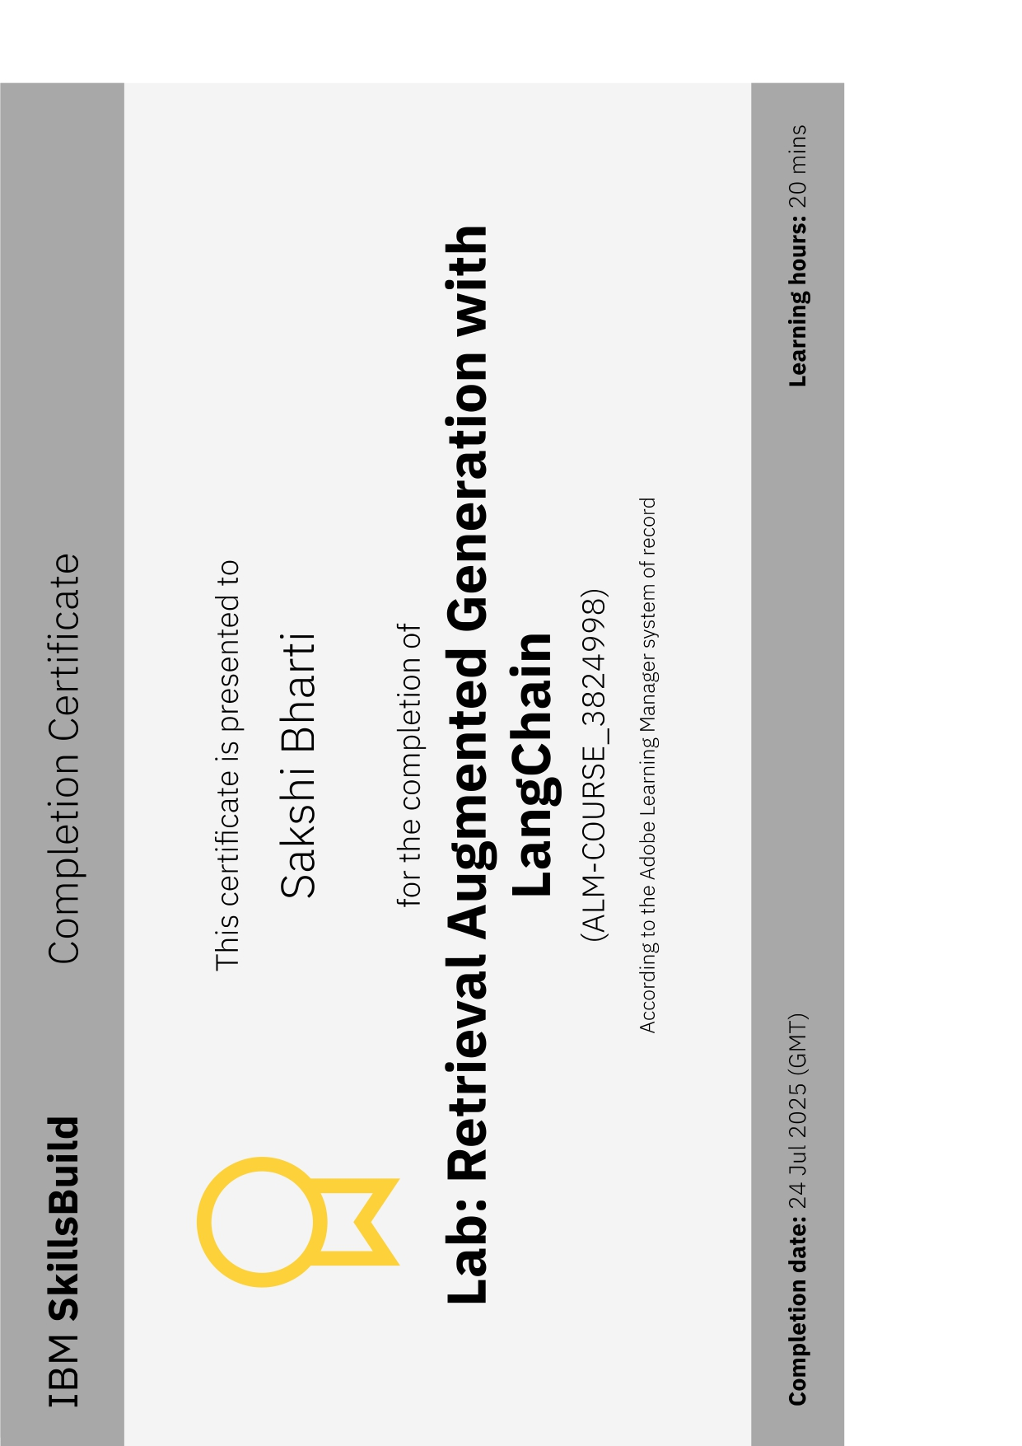
IBM Certifications

Slide 15
THANK YOU

